Slide 1
Chapter 4
Trees
A simple date structures for which the running time for most operations is O(log(N)). IN studying trees we will see how
trees are used to implement file systems
trees are used to evaluate arithmetic expressions
trees are used to support searching operations in O(log(n)) average time.
We will also discuss sets and maps
May 18, 2015 | CECS 302. Instructor: I Imam

Slide 2
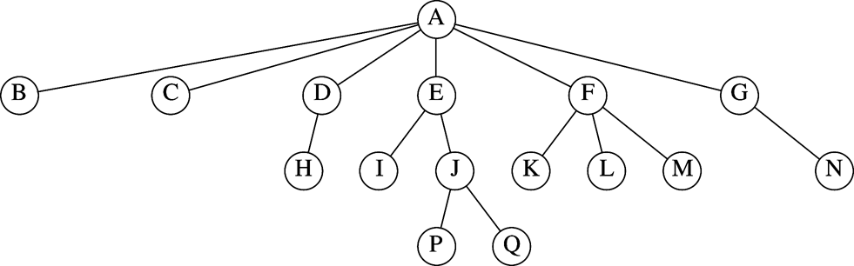
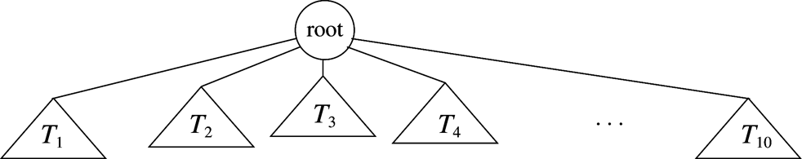
Preliminaries
A tree is a collection of nodes, the collection can be empty otherwise the tree must have a distinguished node r called the root and a zero or more nonempty subtrees T1, T2, ..., Tk each of whose roots are connected by a directed edge from r.
The root of each subtree is a child of r.
r is the parent of the root of each subtree
A tree is a collection of n nodes one of which is the root and n-1 directed edges.
Each edge connects a node to it’s parent. The root has no parent
May 18, 2015 | CECS 302. Instructor: I Imam

Slide 3
Preliminaries (cont.)
A parent may have an arbitrary number of children.
A node that has no children is called a leaf.
A path from node nk to node nl is a sequence of nodes nk, ..., ni, ni+1, ni+2, ..., nl such that ni is the parent of ni+1.
The length of the path is the number of edges in the path. For k nodes the path is of length k-1.
For any node ni, the depth of ni is the length of the unique path from the root to ni.
The height of ni is the length of the longest path to a leaf
The depth of the tree is the depth of the deepest leaf and it the height of the tree.
If there is a path from ni to nj the ni is an ancestor of nj and nj is a descendant of ni. If the path is of length > 0 then this is a proper ancestry
A is the root
J has a parent and two children
H, P and Q are leaves
I and J are siblings
The path from A to Q is AEJQ and it has length 3.
This tree is of height 3
J is at depth 2 and height 1
Oct 20, 2011 | CECS 302. Instructor: I Imam

Slide 4
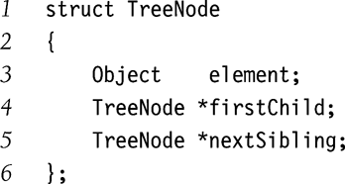
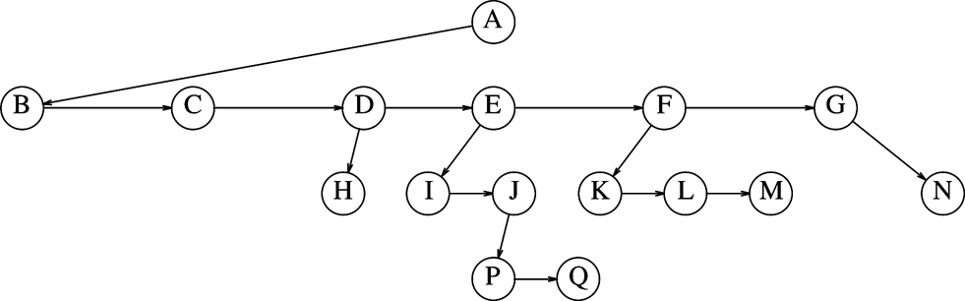
Implementation of Trees
An attempt to implement a tree by using nodes linked to its’ descendants sound intuitive but will fail because number of children for each node is not constant and trying to use a maximum number will yield significant waste.
The implementation used is to have each node point to it’s first child (arrows pointing down) and next sibling (arrows pointing left to right.)
Oct 20, 2011 | CECS 302. Instructor: I Imam

Slide 5
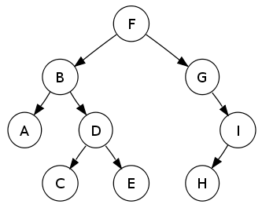
Preorder and Postorder Traversal
In preorder we traverse the tree in the root, left, then right order.
This yields:
F,B,A,D,C,E,G,I,H
In postorder we traverse the tree in the left, right, root order
This yields:
A, C, E, D, B, H, I, G, F
This tree is from wikipedia
Oct 20, 2011 | CECS 302. Instructor: I Imam

Slide 6
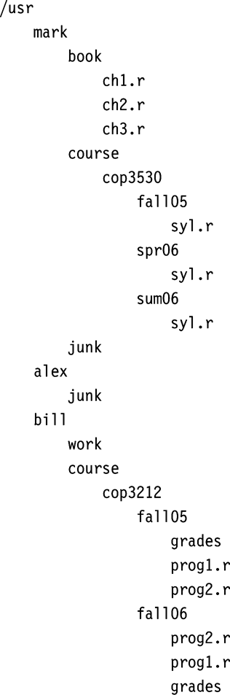
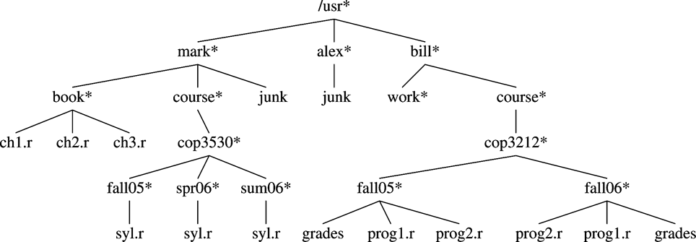
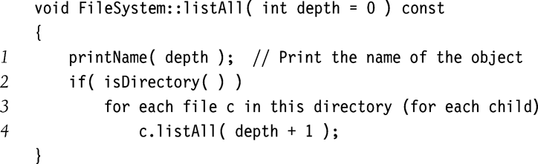
Tree Traversal with an Application
The asterisk indicate a directory
Use the node structure outlined earlier
For each depth increase add one indentation
You need to write your own printName(depth).
In this case we process a node, then its child.
When we reach a leaf we process siblings
When siblings are done we move up one level
This is called preorder traversal
Oct 20, 2011 | CECS 302. Instructor: I Imam

Slide 7
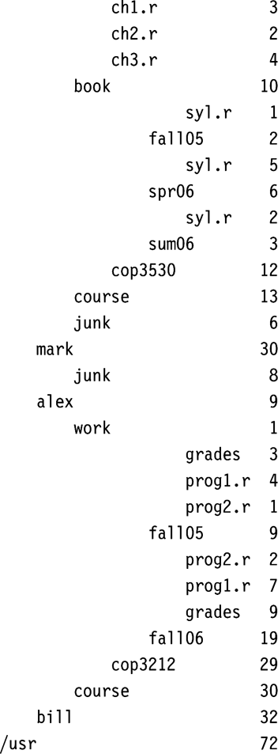

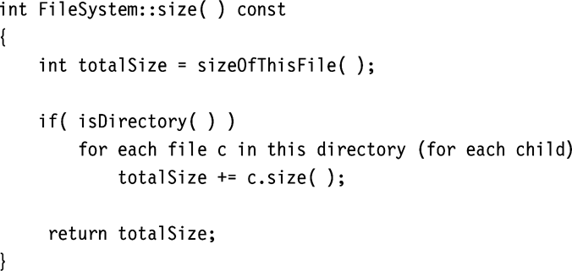
Tree Traversal with an Application
In this case we process a leaf, then its siblings, and its parent.
We move left then up.
We add size when we move from child to parent
This is called postorder traversal
Oct 20, 2011 | CECS 302. Instructor: I Imam

Slide 8
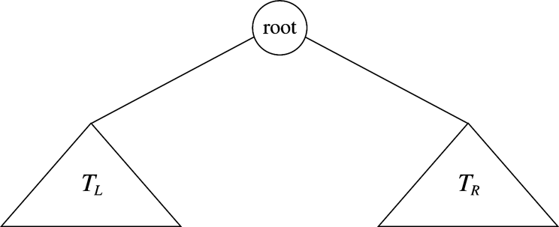
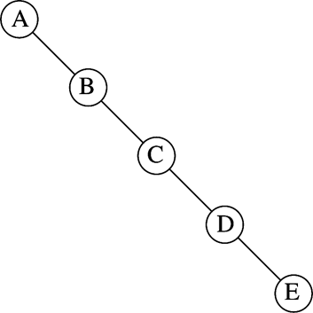
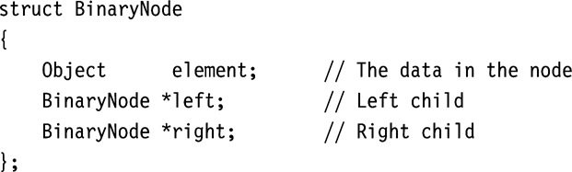
Binary Trees
In binary trees no node can have more than two children.
Binary trees are very useful in representing expressions (most operations we deal with are binary operations.
The operands will end up being the leaves and the operations will become the internal nodes
Unary operations such as the unary minus are nodes with one child only.
Maximum depth can be n-1
Oct 20, 2011 | CECS 302. Instructor: I Imam

Slide 9
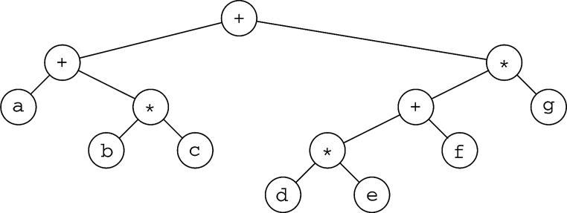
Expression Trees
This is the expression tree for (a+b*c)+((d*e+f)*g)
Inorder traversal is left, root, right
It yields: (a + (b*c))+((d*e+f)*g)
Recall postorder is left, right, root (we saw this when we used stacks to evaluate expressions.
It yields: abc*+de*f+g*+
The preorder root, left, right (Not very useful for expression evaluation)
It yields: ++a*bc*+*defg
Oct 20, 2011 | CECS 302. Instructor: I Imam

Slide 10
Constructing Expression Trees
Given a postfix expression, how do we construct a tree that when traced in a postorder fashion will yield the same expression.
Let us start with ab+cde+** (Remember that this is equivalent to (a+b)*(c*(d+e)))
Oct 20, 2011 | CECS 302. Instructor: I Imam

Slide 11
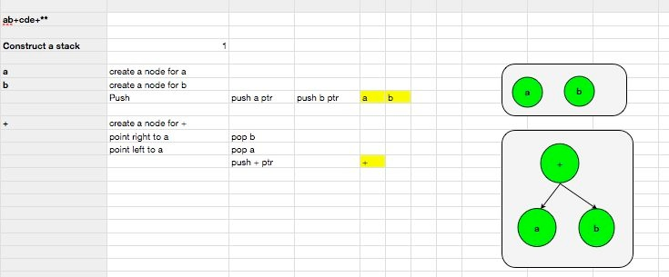
Oct 20, 2011 | CECS 302. Instructor: I Imam

Slide 12
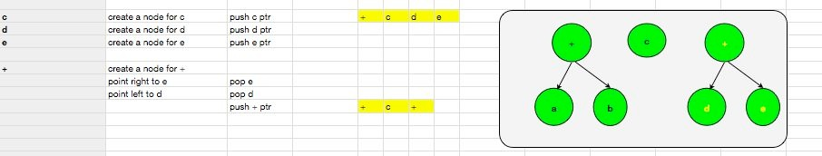
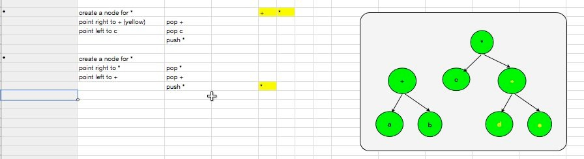
Oct 20, 2011 | CECS 302. Instructor: I Imam

Slide 13
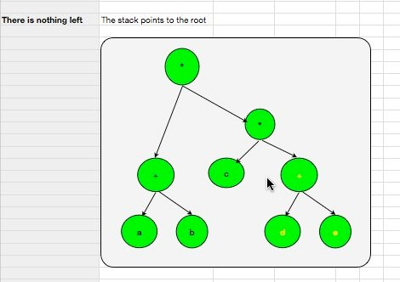
Oct 20, 2011 | CECS 302. Instructor: I Imam

